Slide 1


AI-Based Energy Optimization in IoT Networks
Bangalore Institute of Technology
K.R. Road, VV Puram, Bangalore-560004
Department of Electronics and Communication Engineering
Mini-Project Presentation
Under the guidance of:
Presented by
Dr. Anupama H,
Assistant Professor
Dept. of ECE
BIT.
Ayush Kumar (1BI23EC029)
Prajwal kumar (1BI23EC110)

Slide 2
Institute Vision and Mission
Vision:
To establish and develop the Institute as a center of higher learning, ever abreast with the expanding horizon of knowledge in the field of engineering and technology, with entrepreneurial thinking, leadership excellence for life-long success, and the ability to solve societal problems.
Mission:
Provide high-quality education in the engineering disciplines from the undergraduate through doctoral levels with creative academic and professional programs. Develop the Institute as a leader in science, engineering, technology, and management, research, and apply knowledge for the benefit of society. Establish mutually beneficial partnerships with industry, alumni, local, state, and central governments by public service assistance and collaborative research. Inculcate personality development through sports, cultural, and extracurricular activities and engage in the social, economic, and professional challenges.
Bangalore Institute of Technology
Dept. of ECE, BIT

Slide 3
Department Vision , Mission, PEOs, PSOs
Vision: Imparting Quality Education to achieve Academic Excellence in Electronics and Communication Engineering for Global Competent Engineers.
Mission: Create state of art infrastructure for quality education.
Nurture innovative concepts and problem solving skills.
Delivering Professional Engineers to meet the societal needs.
PEOs:
Prepare graduates to be professionals, practicing engineers, and entrepreneurs in the field of Electronics and Communication. Acquire sufficient knowledge for innovative techniques in the design and development of systems, and compete globally in multidisciplinary fields. Achieve personal and professional success with awareness and commitment to ethical and social responsibilities, both individually and as a team. Graduates will maintain and improve technical competence through continuous learning.
PSOs:
PSO1: Core Engineering: The graduates will be able to apply the principles of Electronics and Communication in core areas.
PSO2: Soft Skills: An ability to use latest hardware and software tools in Electronics and Communication engineering.
PSO3: Successful Career: Preparing Graduates to satisfy industrial needs and pursue higher studies with social-awareness and universal moral values.
Bangalore Institute of Technology
Dept. of ECE, BIT

Slide 4
Course Outcomes of Mini-Project
1 | Ability to carry-out literature review and define the problem.
2 | Ability to co-ordinate to work as a team member or a single member.
3 | Inculcate methods to use advance tools .
4 | Design analytical modeling and develop a systems
5 | Ability to equip analysis skills and interpretation.
6 | Enhance presentation skills, drafting and documentation of project work.
CO-PO Mapping Table
PO CO | 1 | 2 | 3 | 4 | 5 | 6 | 7 | 8 | 9 | 10 | 11 | 12 | PSO 1 | PSO 2 | PSO 3
1 | 3 | 2 | 2 |  |  | 1 |  | 1 | 1 | 1 |  |  | 2 | 2
2 | 3 | 2 | 2 |  |  | 1 |  | 1 | 1 | 1 |  |  | 2 | 2
3 | 3 | 2 | 2 |  | 3 |  |  | 1 | 1 | 1 |  |  | 2 | 2
4 | 3 | 2 | 2 |  | 3 | 1 |  | 1 | 1 | 1 |  |  | 2 | 2
5 | 3 | 2 | 2 |  | 3 | 1 |  | 1 | 1 | 1 |  |  | 2 | 2
6 | 3 |  |  |  | 3 |  |  | 1 | 1 | 1 | 2 |  | 2 | 2
Bangalore Institute of Technology
Dept. of ECE, BIT

Slide 5
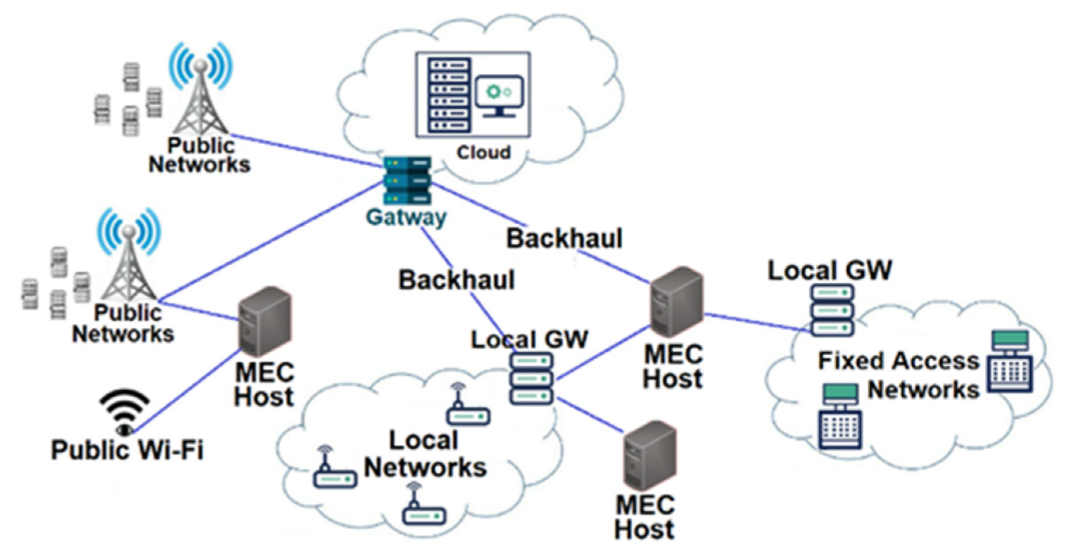
Abstract
IoT sensor networks face serious energy challenges due to limited batteries.
Proposed project: an AI-driven scheduler that optimizes node sleep/wake cycles and transmissions.
Implemented in MATLAB with RL models.
Expected impact: reduce energy waste, extend lifetime, and support green-tech sustainability.
Bangalore Institute of Technology
Dept. of ECE, BIT

Slide 6
Table of Contents
Sl No. | Topic | Slide No.
1. | Introduction | 7
2. | Literature Survey | 8-9
3. | Objective | 10
4. | Methodology | 11
5. | Hardware & Software Requirements | 12
6. | Block Diagram / Designed System | 13
7. | Expected Results | 14
8. | Conclusion | 15
Bangalore Institute of Technology
Dept. of ECE, BIT

Slide 7
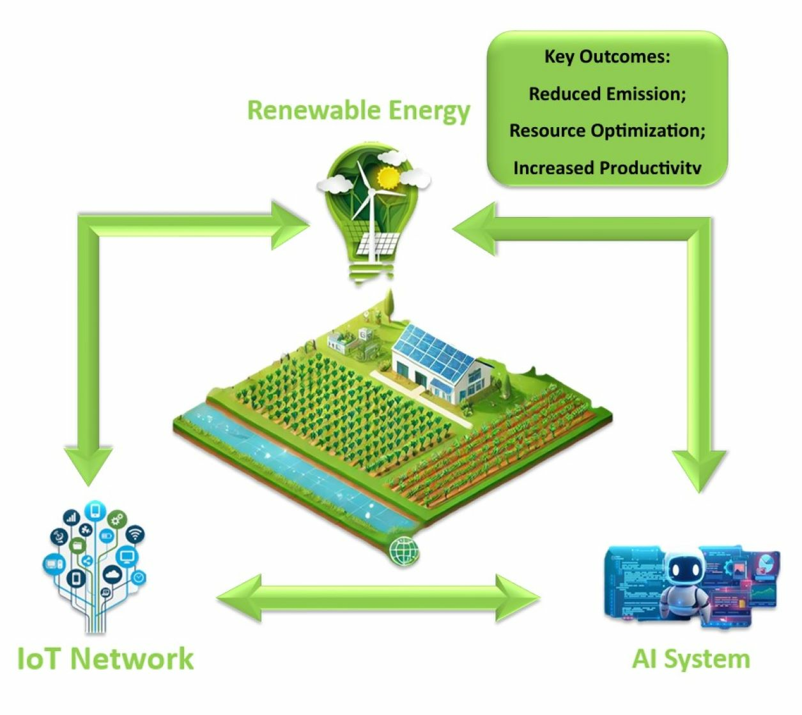
Introduction
The IoT connects billions of battery-powered sensor nodes for applications like smart cities, healthcare, and agriculture.
A key challenge: energy waste from idle listening, collisions, and fixed duty cycles → shortens network lifetime & increases e-waste.
Traditional MAC/routing protocols (CSMA/CA, TDMA, static duty cycles) are inefficient in dense, heterogeneous IoT networks.
Our project introduces an AI-based scheduler using Reinforcement Learning (RL) to dynamically optimize sleep/wake cycles and transmissions.
Goal: maximize energy efficiency + extend network lifetime, while maintaining QoS in terms of latency, reliability, and packet delivery.
Bangalore Institute of Technology
Dept. of ECE, BIT

Slide 8
Literature Survey
S.No | Topic | Author and Year of Publication | Relevance
1.
2.
3.
“Energy-Efficient Routing via Multi-Agent RL”
Balances energy, avoids hotspots, extends lifetime
Zhao & Chen (2025)
“Vision-Based Coverage Optimization"
Multi-agent DRL reduces energy by 32% & extends lifetime by 45%
Ahmed & Singh (2025)
“RL-BMAC Protocol”
Deep Q-Network agents optimize sleep/wake scheduling using real-time metrics
Sharma & Gupta (2024)
Bangalore Institute of Technology
Dept. of ECE, BIT

Slide 9
Literature Survey
S.No | Topic | Author and Year of Publication | Relevance
5.
6.
“RL-MAC Surveys”
Highlights adaptive channel access & optimization of CSMA protocols
Kumar & Patel (2023)
“Opportunistic Duty-Cycled MAC”
Reviews protocols for energy efficiency & delivery performance
Li & Wang (2020)
Bangalore Institute of Technology
Dept. of ECE, BIT

Slide 10

Objectives
Simulate IoT sensor network with energy models in MATLAB
Train AI-based scheduler for sleep/wake + transmit decisions
Compare with CSMA/CA, static duty cycle, and TDMA
Evaluate metrics: lifetime, energy/bit, packet delivery ratio, latency
Align with green technology goals
Bangalore Institute of Technology
Dept. of ECE, BIT

Slide 11

Methodology
Setup IoT network in MATLAB (nodes + batteries + traffic).
RL scheduler trained on energy, traffic load, link quality.
Scheduler outputs sleep/wake + transmission decisions.
Compare performance with baseline protocols.
Analyze results: energy savings, PDR, latency, network lifetime.
Bangalore Institute of Technology
Dept. of ECE, BIT

Slide 12

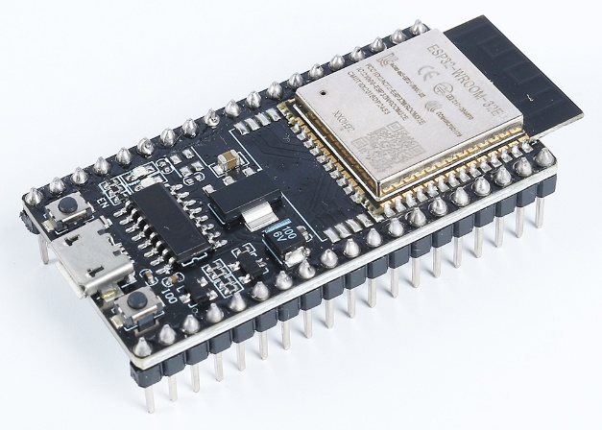
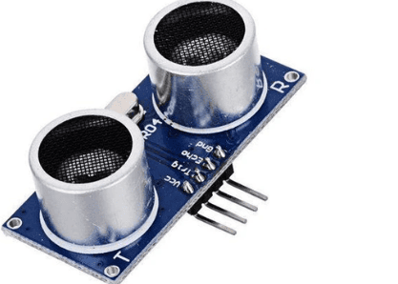
Hardware a Software Requirements
Software:
MATLAB/Simulink + RL Toolbox
Alternative: Python (Gym)
ONNX / TF Lite for embedded inference
Hardware (future prototype):
ESP32 / STM32 MCU
BLE 5.0 / 802.15.4 radios
Sensors: temp, humidity, vibration
Coin-cell / AA batteries
Bangalore Institute of Technology
Dept. of ECE, BIT

Slide 13
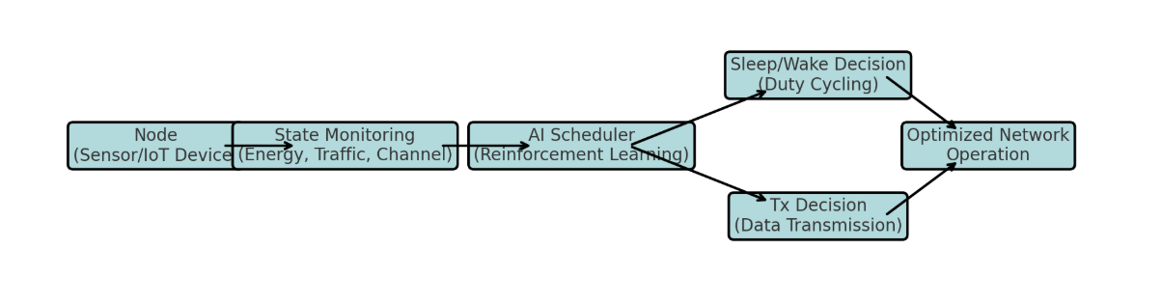
DESIGNED SYSTEM
Node → State Monitoring (energy, traffic, channel) → AI Scheduler → Sleep/Wake + Tx Decision → Optimized Network Operation
AI-Based Energy Optimization in IoT Networks
Bangalore Institute of Technology
Dept. of ECE, BIT

Slide 14

Excepted Results
Energy Savings
Anticipated reduction of 20–50% energy/bit compared to CSMA/CA.
Additional 10–25% savings over static duty-cycle methods.
Results in less idle listening, fewer retransmissions, and smarter channel usage.
Network Lifetime Extension
+30–80% increase in time-to-first-node-death.
Better load balancing ensures that all nodes drain energy more uniformly.
Enables longer deployments with fewer battery replacements.
Quality of Service (QoS) Preservation
≥95% packet delivery ratio (PDR) for both periodic and event-driven traffic.
Low 95-percentile latency maintained within deadlines, even during bursty traffic.
Aggregation-aware scheduling ensures timely delivery without energy waste.
Green Technology Impact
Reduces electronic waste by minimizing battery swaps.
Supports sustainability goals in large-scale IoT deployments.
Bangalore Institute of Technology
Dept. of ECE, BIT

Slide 15
Conclusion
Our AI-driven Reinforcement Learning scheduler offers a significant advancement in energy-efficient IoT network management. By intelligently optimizing sleep/wake cycles and transmission scheduling:
Energy Efficiency: Achieves up to 50% reduction in energy per bit compared to CSMA/CA and an additional 10–25% improvement over static duty-cycle methods, minimizing idle listening and retransmissions.
Network Lifetime Extension: Extends network lifetime by 30–80%, with uniform energy consumption across nodes, enabling longer deployments with fewer battery replacements.
Quality of Service (QoS): Maintains ≥95% packet delivery ratio and low latency, even under bursty or heterogeneous traffic, ensuring reliable and timely data delivery.
Sustainability Impact: Reduces electronic waste and supports green technology goals by minimizing battery swaps and promoting longer-lasting sensor networks.
Overall, our approach demonstrates that intelligent, adaptive scheduling can simultaneously maximize energy efficiency, maintain QoS, and promote environmental sustainability, making it highly suitable for dense, heterogeneous IoT deployments in smart cities, healthcare, and agriculture.
Bangalore Institute of Technology
Dept. of ECE, BIT

Slide 16
References
Zhao, H., & Chen, L. (2025). Energy-efficient routing in WSNs using multi-agent Q-learning. arXiv:2502.04567.
Ahmed, T., & Singh, P. (2025). Adaptive vision-based coverage optimization using DRL in WSNs. arXiv:2503.07891.
Sharma, A., & Gupta, R. (2024). RL-BMAC: Reinforcement learning-based MAC protocol. Sensors, 24(12), 4550.
Kumar, S., & Patel, M. (2023). Survey of RL-based MAC protocols in wireless ad-hoc networks. Electronics, 12(18), 3890.
Li, X., & Wang, Y. (2020). Opportunistic routing with duty-cycled MAC in WSNs. Sensors, 20(22), 6543.
Additional references from RL-based energy optimization studies (2022–2025) covering duty-cycle scheduling, fuzzy logic, and federated learning approaches.
Bangalore Institute of Technology
Dept. of ECE, BIT

